Slide 1

Classification Problem
IBM HR Analytics Employee Attrition & Performance

Slide 2
Objective
Predict the attrition of the IBM employees
Get the highest Recall Score

Slide 3



Dataset Info
35 columns
Numerical: 36
Object: 9
1470 Data Points
No Missing Values

Slide 4
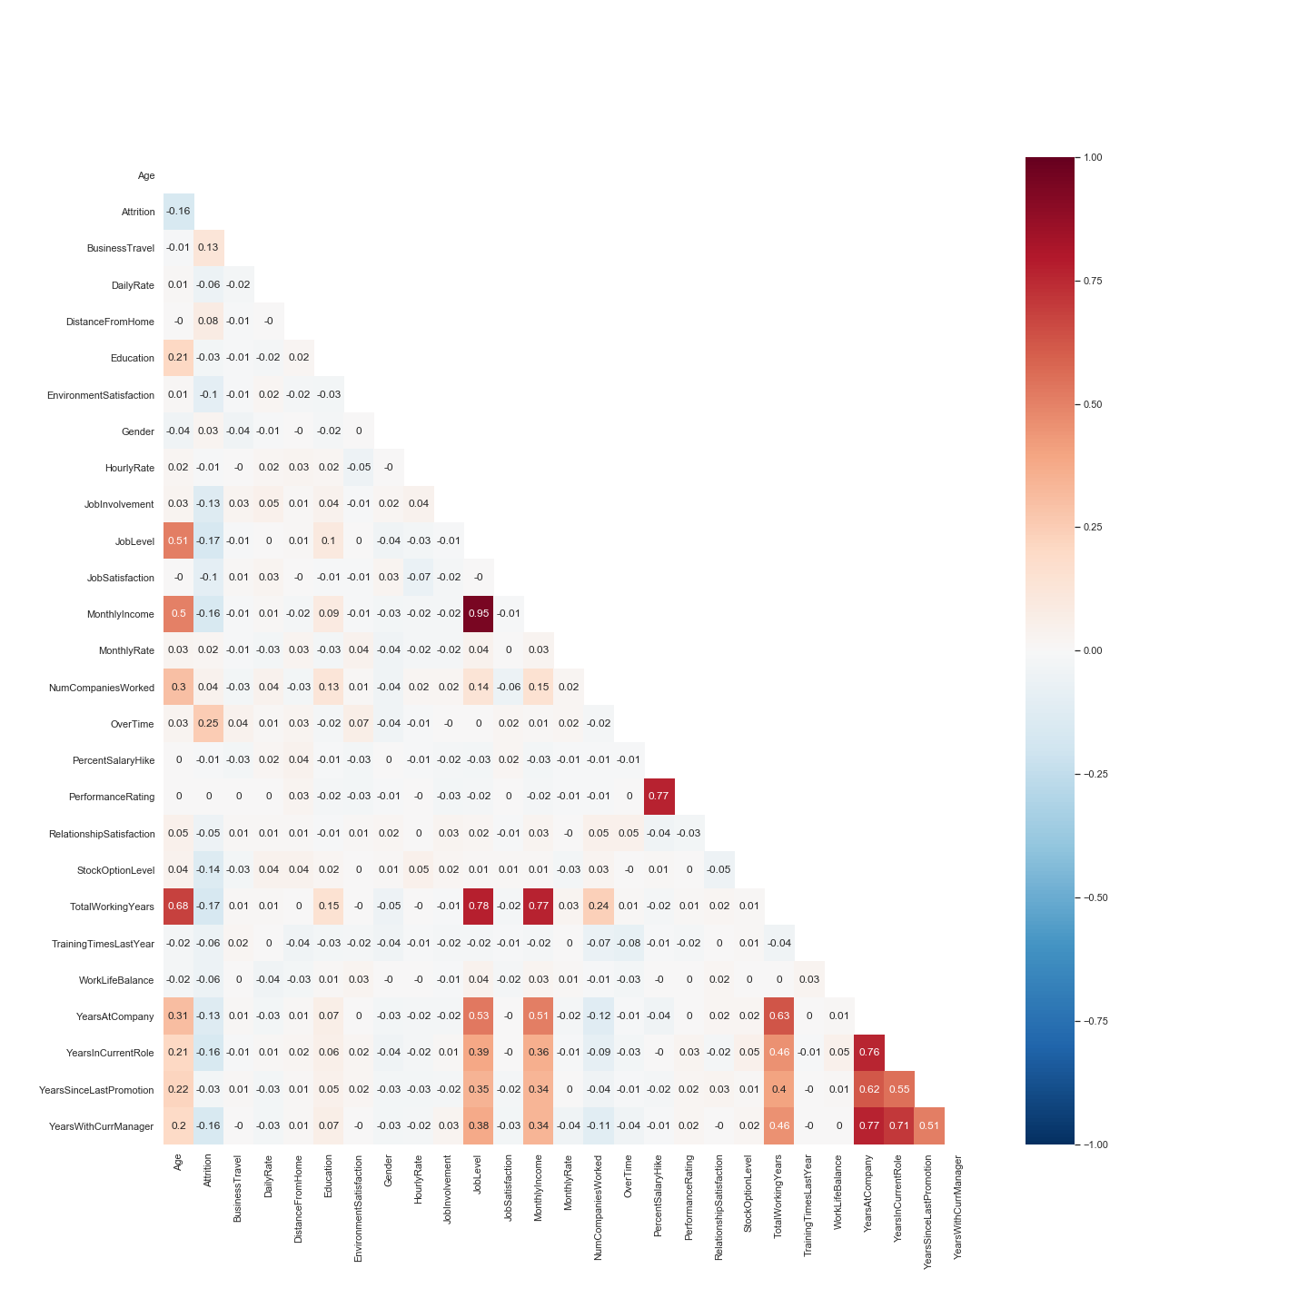
Data Cleaning
Drop columns that were highly correlated and had only one value
Encode the object columns that were ordinal
Create dummies for the rest of the columns that were objects

Slide 5
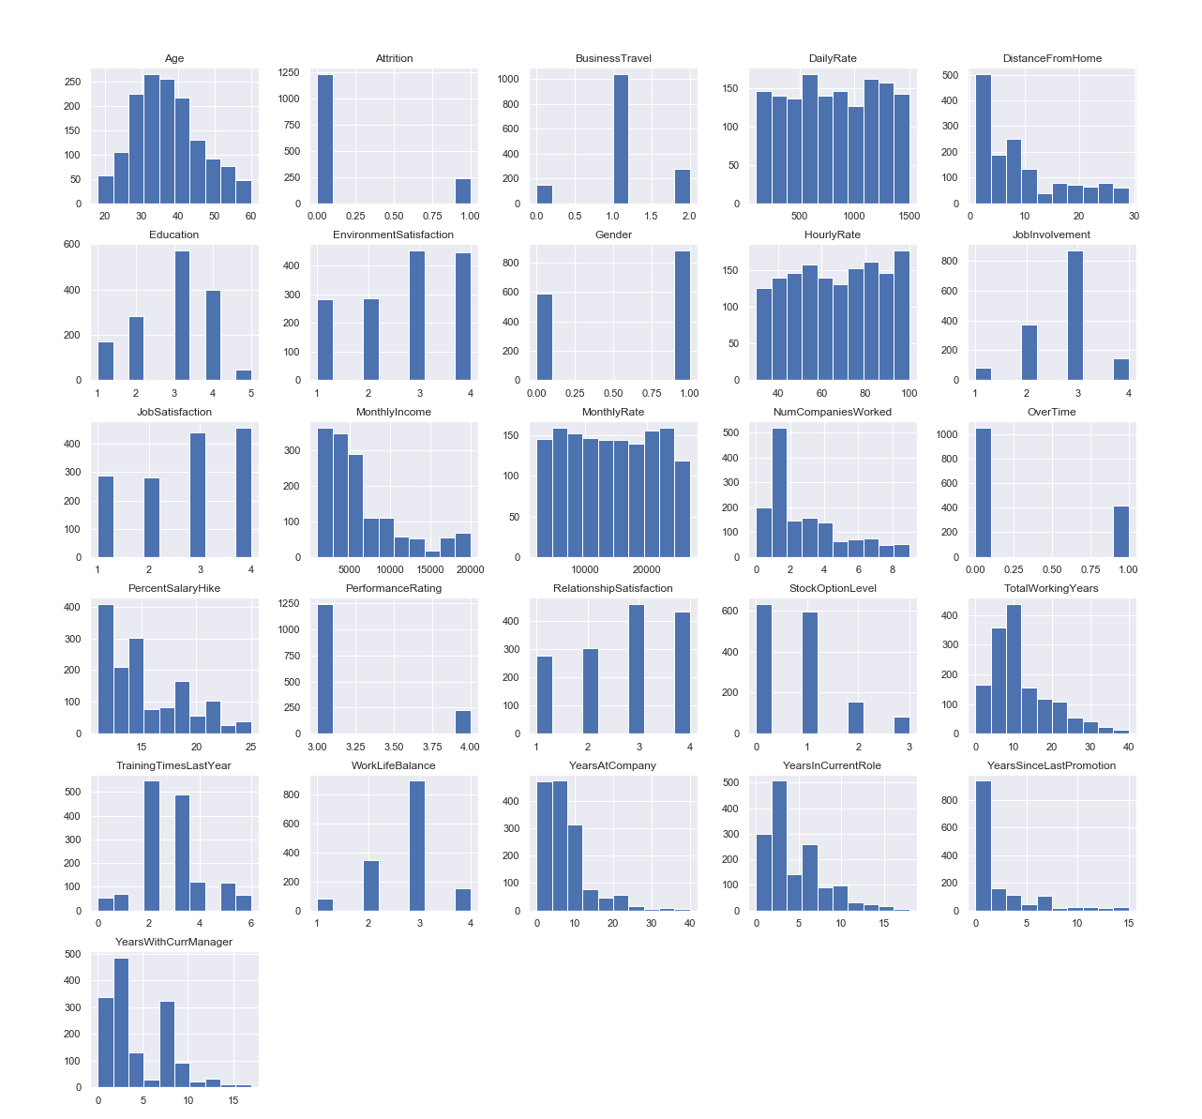
Normalize And Standardize

Slide 6
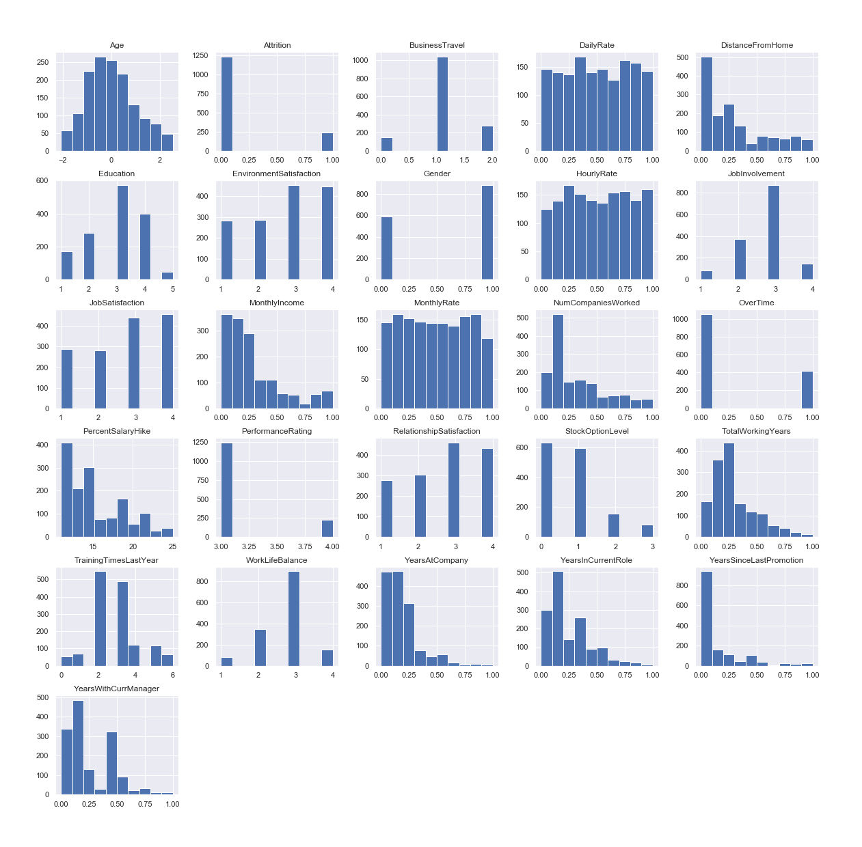
Normalize And Standardize

Slide 7
Imbalanced Variable

Slide 8
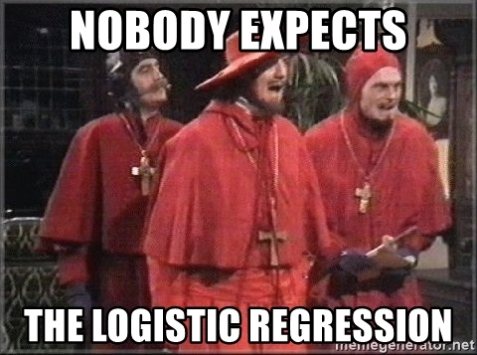






Models Used

Slide 9
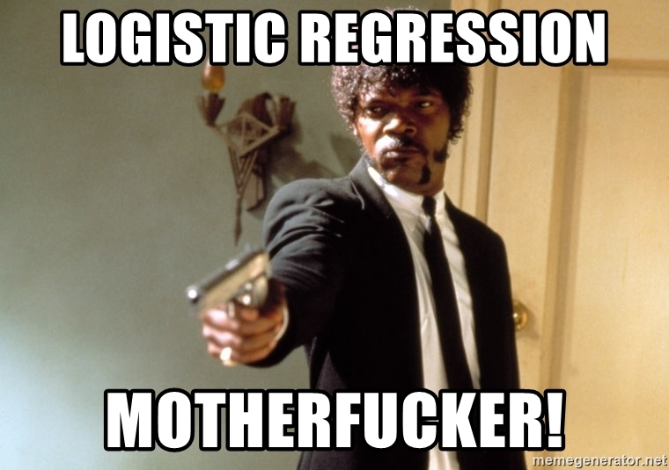
WINNER!

Slide 10
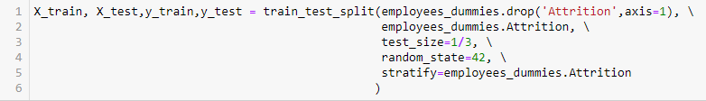
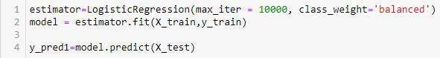
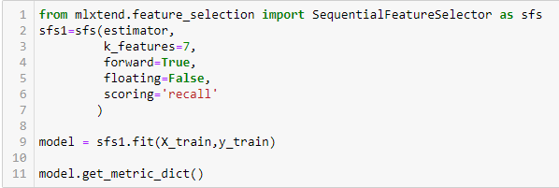
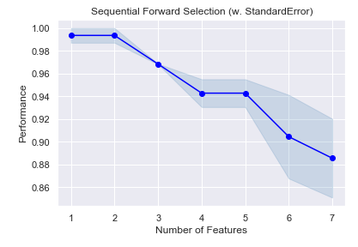
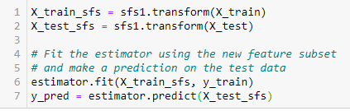
Recall Score
98,73%
Test Set
TN 26 | FN 1
FP 385 | TP 78
Notes:
Important notes:
- Stratify in train and test split in order to preserve the same proportion of Yes and No values
- Add the parameter class_weight=‘balanced’ in order to optimize the model for na imbalanced variable
- Add the parameter scoring=‘recall’ in order to optimize the recall score

Slide 11
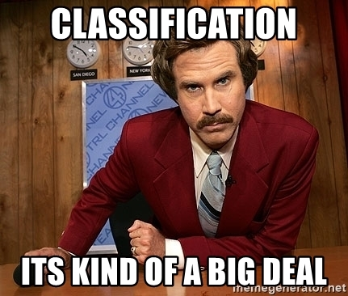
What I have learned
Cleaning and transforming the data before running the models is important
There is no best model for every dataset
Tune each model in order to optimize the score that I wanted

Slide 12
What I would have done differently
Try to reduce the number of columns
Try using PCA and MCA to improve the models
Analyze more closely each column to better understand the dataset

Slide 13
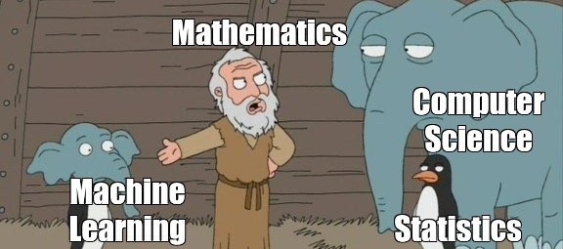
THANK YOU FOR YOUR ATTENTION!

